Slide 1

Streamlining Software Development Processes with Azure DevOps and Power BI Dashboard
Bharath Kumar Gopu
Dinesh Garampally
Praveen Kumar Keshaboina
Sreya Sree Siloju
Venkata Sai Rishitha Seelam

Slide 2
Agenda
Introduction
Overview Of Azure DevOps and Power BI
Project Demonstration
Benefits
Conclusion and future scope
Presentation Title

Slide 3

Introduction
Software development processes are crucial for successful project outcomes. Managing these processes efficiently can be challenging due to complex workflows and evolving requirements. Azure DevOps and Power BI offer powerful solutions to streamline and optimize software development processes. By combining Azure DevOps' comprehensive features and Power BI's data visualization capabilities, we can gain valuable insights and make informed decisions.

Slide 4


The main goal of our project is to optimize the process of showcasing the progress of multiple projects in an organization by integrating power bi and Azure DevOps.
Main Goal

Slide 5
Overview of Azure DevOps
Azure DevOps is a comprehensive set of development tools and services.
Supports the entire software development lifecycle from planning to deployment.
Key components: Azure Boards, Azure Repos, Azure Pipelines, Azure Test Plans, Azure Artifacts.
Promotes collaboration, automation, and transparency among development teams.
Integration with popular development tools and platforms.
Supports Agile, Scrum, and Kanban methodologies.
Built-in analytics and reporting capabilities.

Slide 6
Overview of Power BI
Power BI is a powerful business intelligence and data visualization tool.
Enables data analysis, insights, and informed decision-making.
Connects to various data sources, including databases and online services.
Creates interactive reports, dashboards, and presentations.
Offers a wide range of visualization options.
Real-time and scheduled data refresh options.
Enables collaboration and sharing of reports and dashboards.
Integrates with Microsoft tools and services.
Advanced analytics capabilities, including AI-powered features.

Slide 7

Project Demo

Slide 8
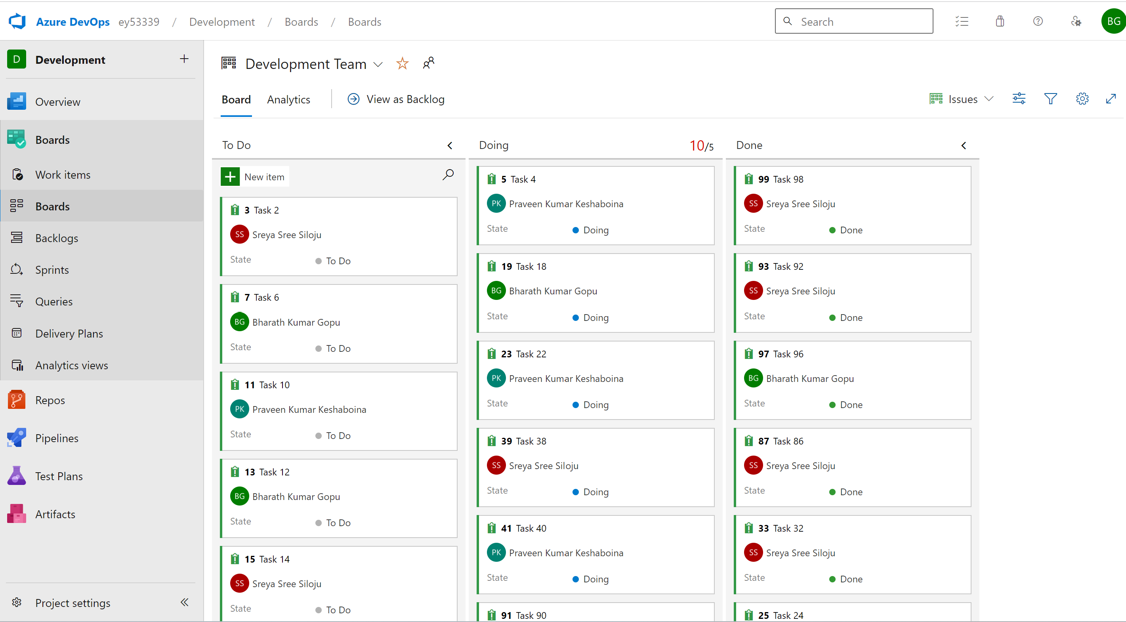
Outputs
Importing an excel file for automatic creation of boards

Slide 9
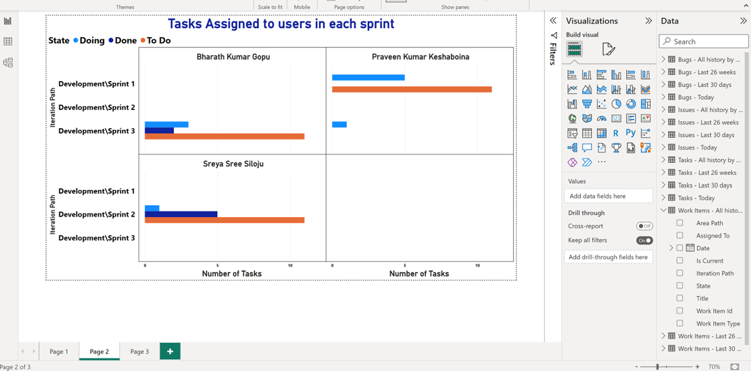
Outputs
Generating Visualizations by integrating Azure DevOps boards with Power Bi

Slide 10
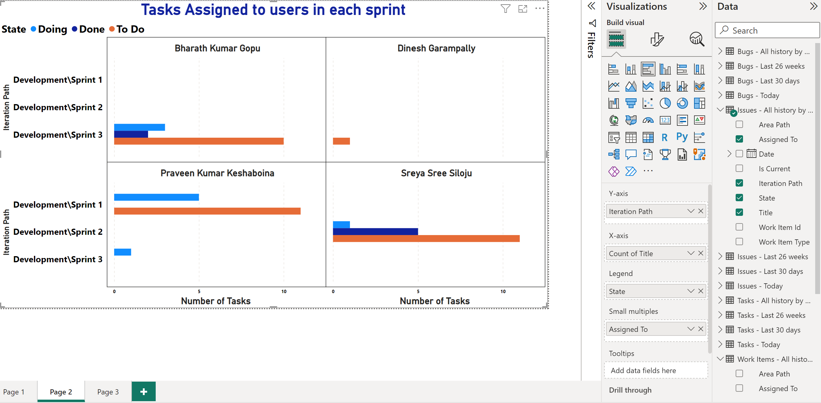
Outputs
Visualization after Modifying Azure Boards

Slide 11
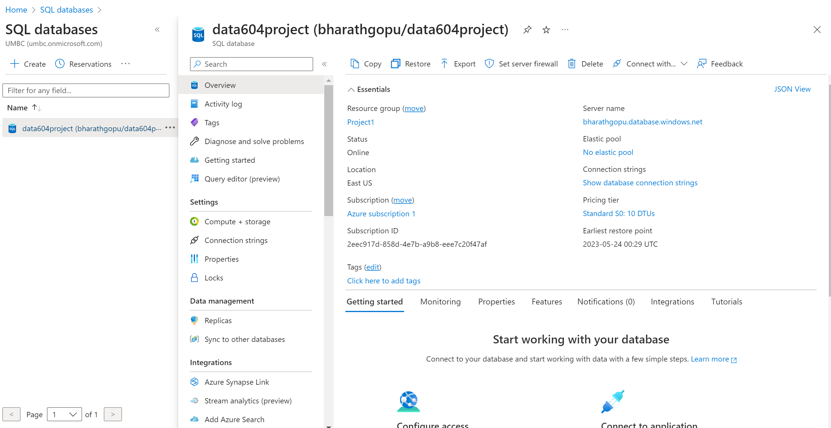
Outputs
Created a new azure Database – data604Project

Slide 12
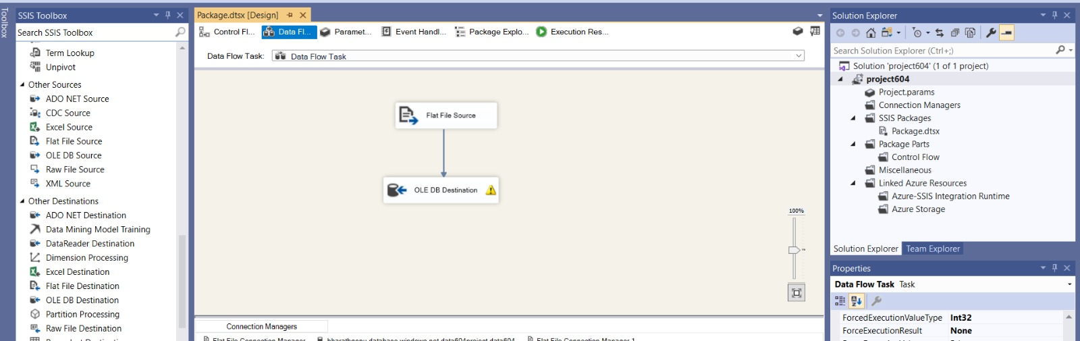
Outputs
Using SSIS, Deploying the power BI reports to Azure SQL database

Slide 13
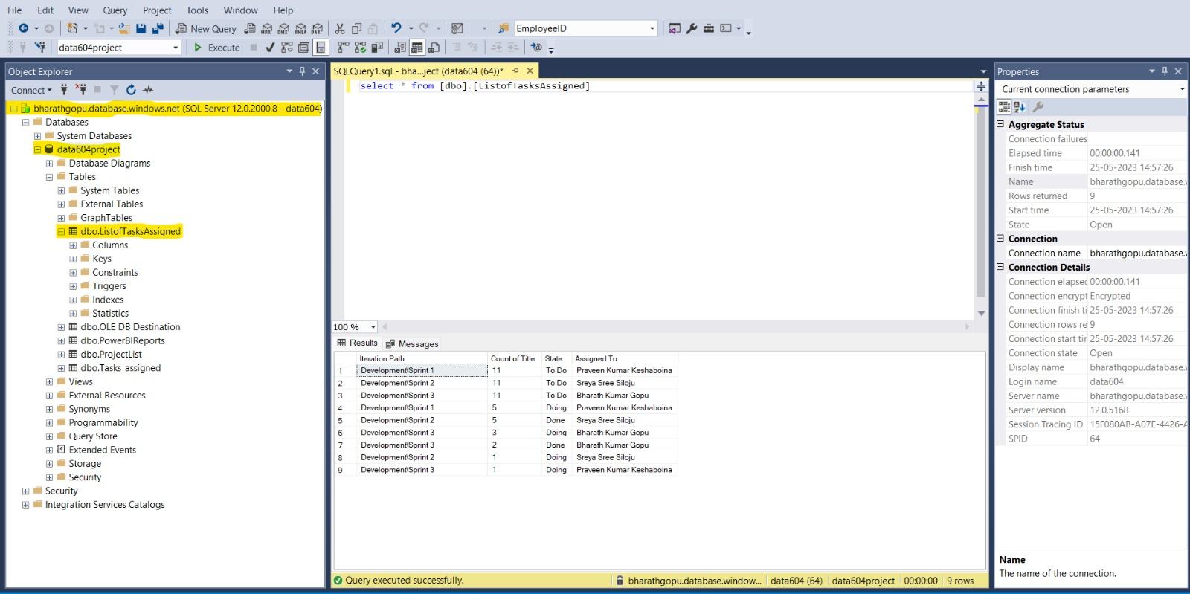
Outputs
Screenshot showing successful deployment of power BI reports to azure SQL database

Slide 14
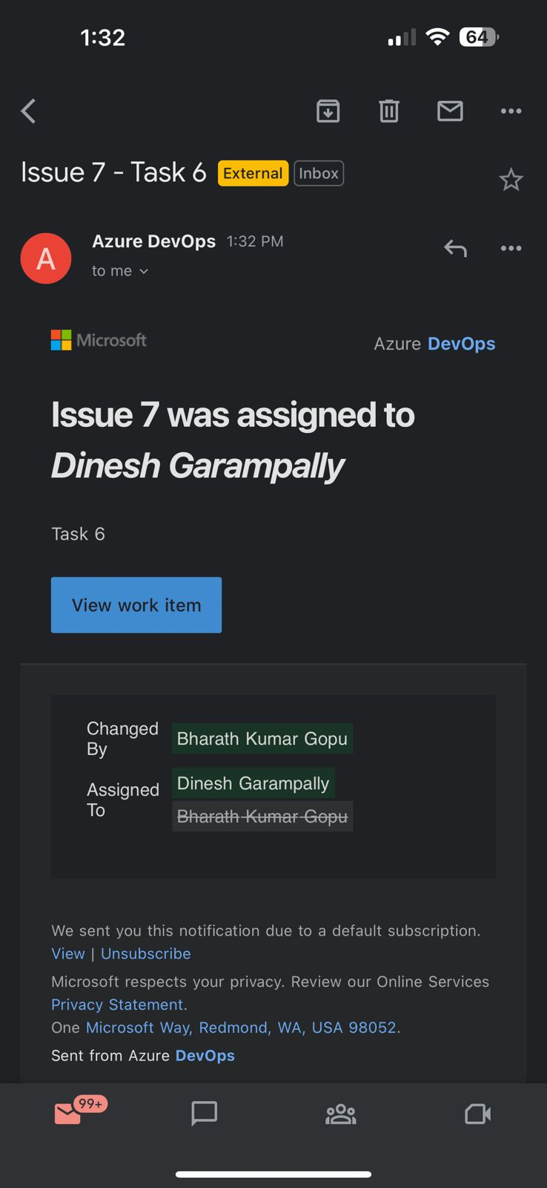
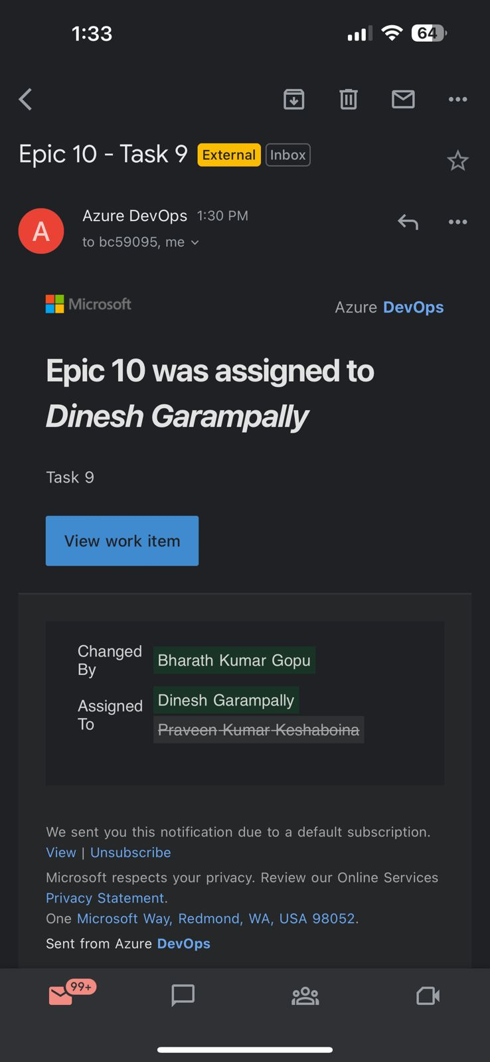
Outputs
Triggering Email Notifications whenever modifications made on Azure DevOps Boards

Slide 15
Benefits
Enhanced Efficiency
Improved Visibility
Data-Driven Insights
Effective Resource Management
Seamless Integration
Enhanced Collaboration
Real-Time Monitoring
Improved Decision-Making

Slide 16
Conclusion
By leveraging the powerful capabilities of Azure DevOps and Power BI, teams can achieve enhanced efficiency, improved visibility, and data-driven insights throughout the development lifecycle.
The seamless integration between Azure DevOps and Power BI enables teams to collaborate effectively, make informed decisions, and optimize resource management.
Real-time monitoring and proactive issue identification contribute to agile and adaptive project management.
The project empowers stakeholders with interactive dashboards and reports, providing valuable insights and facilitating data-driven decision-making.
By implementing this solution, organizations can achieve optimized software development processes, leading to improved productivity, quality, and project success.
Streamlining software development with Azure DevOps and Power BI Dashboard represents a strategic investment in achieving operational excellence and driving business outcomes.

Slide 17
Future Scope
Advanced Analytics: Explore the integration of advanced analytics techniques, such as machine learning and predictive modeling, to gain deeper insights into software development processes and drive proactive decision-making.
Integration with Additional Tools: Investigate integrating other tools and services into the workflow, such as project management software, testing frameworks, or customer relationship management (CRM) systems, to further streamline and enhance the development process.
Direct Integration of Azure SQL data base with Azure DevOps using Azure DevOps REST API’s.

Slide 18




Thank you

